Slide 1

Sociology H Social Sciences
(Sociological versus common sense
explanations)
Today’s class outline
Sociological thinking
Examples & origins of common sense/naturalistic thinking
Private troubles/public issues

Slide 2

Suggested texts
Sociology Alive (2nd edition)
Stephen Moore
Stanley Thornes Publishers Ltd
Sociology a new approach (3rd edition)
Haralambos, Smith, O’Gorman, Heald
Causeway Press

Slide 3
What is distinctive about sociological thinking?
The study of human behaviour
is not unique to sociology
What makes sociology
distinctive is not what is studied
but how it is studied
Most of us will be familiar with
‘common sense’ answers to
social questions and may rely on a number of non-sociological ways of thinking

Slide 4

‘Common Sense' Explanations
‘Common sense is not something rigid and stationary. It creates the folklore of the future…of popular knowledge in a given time and place.’ Antonio Gramsci
Or, as Gary Young (2008) puts it, ‘Common sense represents the received wisdom of years and the widespread opinion of the day. It may be rooted in fact, fiction, rumour or reality. On one level it doesn’t matter. So long as it is commonly held, then, in essence, common sense becomes a fact of life.’

Slide 5
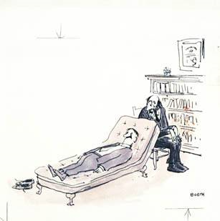
Examples of typical ways of thinking
Biological arguments
– gender
Psychological arguments
– suicide
Moralistic arguments
– poverty
Notes:
What specific ideas concerning the examples above might the public give to illustrate these?

Slide 6
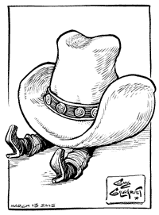
Origins of these ways of thinking
These viewpoints derive from:
Individualistic assumptions
that don’t recognise the
importance of wider social
forces
Naturalistic assumptions
that don’t recognise that
behaviour is primarily
social (learned)
Notes:
Naturalistic…: What is this process called? (Socialisation)

Slide 7
Origins of these ways of thinking
The essential points are:
One person’s ‘common sense’ is often another persons ‘nonsense’
That there is probably no such thing as ‘a’ human nature except in a very restricted sense that would not include most forms of what we would call behaviour

Slide 8
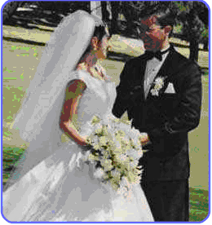
Examples of sociological explanation
Marriage
Naturalistic (common
sense) explanation: It is
only natural that a man and
woman should live together
for life because they fall in
love and want to raise children
Sociological explanation: Monogamy (one woman and one man) is only one form of mating. Mating patterns depend on a variety of economic and social factors. Marriage is a human institution.

Slide 9
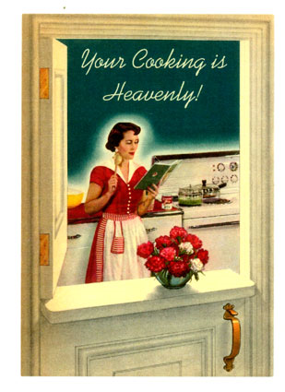
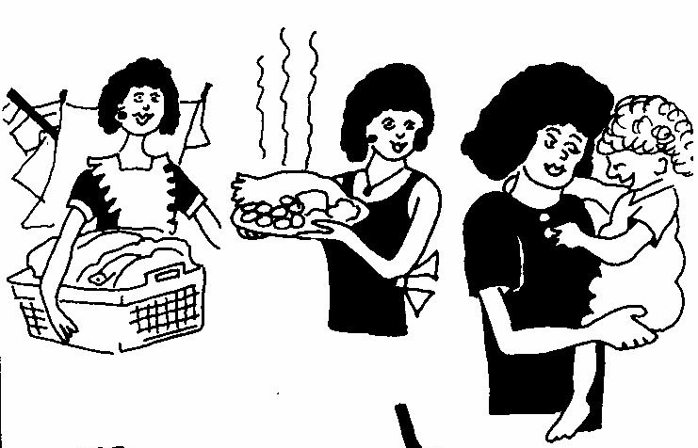
Examples of sociological explanation
The domestic role of women
Naturalistic (common sense)
explanation: Women raise
children because this satisfies
maternal instincts, and the
children’s need for a mother
Sociological explanation:
Ideals concerning
domesticity and
femininity
confine women to the
home

Slide 10
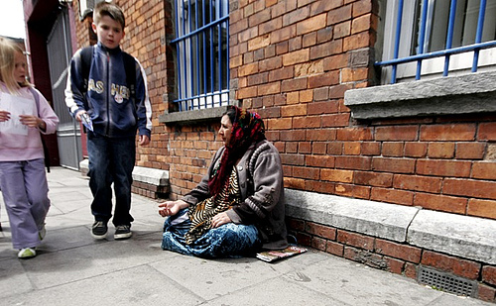

Examples of sociological explanation
Poverty
Individualistic
explanation (common
sense): People are poor because they are lazy or stupid and can’t handle money, or have no skills
Sociological explanation:
Poverty is caused by inequality
in society, and is experienced by those who suffer from a chronic irregularity of work, low wages and unemployment

Slide 11


Examples of sociological explanation
Suicide
Individualistic explanation
(common sense): The most
individual of all acts,
committed by a person
who is unhappy or mentally ill
Sociological explanation:
Suicide is socially patterned.
Suicide is governed primarily
by social factors such as
religion, family and marriage patterns, and not by individual factors

Slide 12

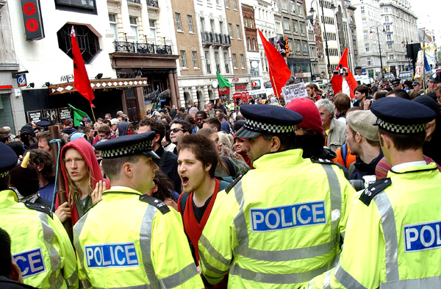
Private troubles/public issues

Slide 13
Private troubles/public issues
When starting to think sociologically, it is
important to try and start by asking the right
questions. To do this, we need to employ
what Mills called ‘the Sociological
Imagination’.
If one person is unemployed, Mills argued that this
was a personal problem, and for that person, a
trouble. As long as there are jobs available, we look
to character or training for an explanation. But,
when a large proportion of a nation's labour force is
unemployed, it is impossible to explain this in terms
of individuals.

Slide 14
Private troubles/public issues
We instead look at the groups they belong to and
their organization, the way society is organised, for
an explanation. It becomes a public issue. Another
example given by Mills is of marriage. If one
marriage fails, this is a personal trouble. When, as
in contemporary western society, divorce assumes
epidemic proportions, then although it appears as a
personal problem to each couple, we are justified in
seeking an explanation outside of individuals. The
same point could be made as regards other
sociological concerns, for example: child abuse,
domestic violence and poverty.

Slide 15
This powerpoint was kindly donated to www.worldofteaching.com
http://www.worldofteaching.com is home to over a thousand powerpoints submitted by teachers. This is a completely free site and requires no registration. Please visit and I hope it will help in your teaching.

